Slide 1
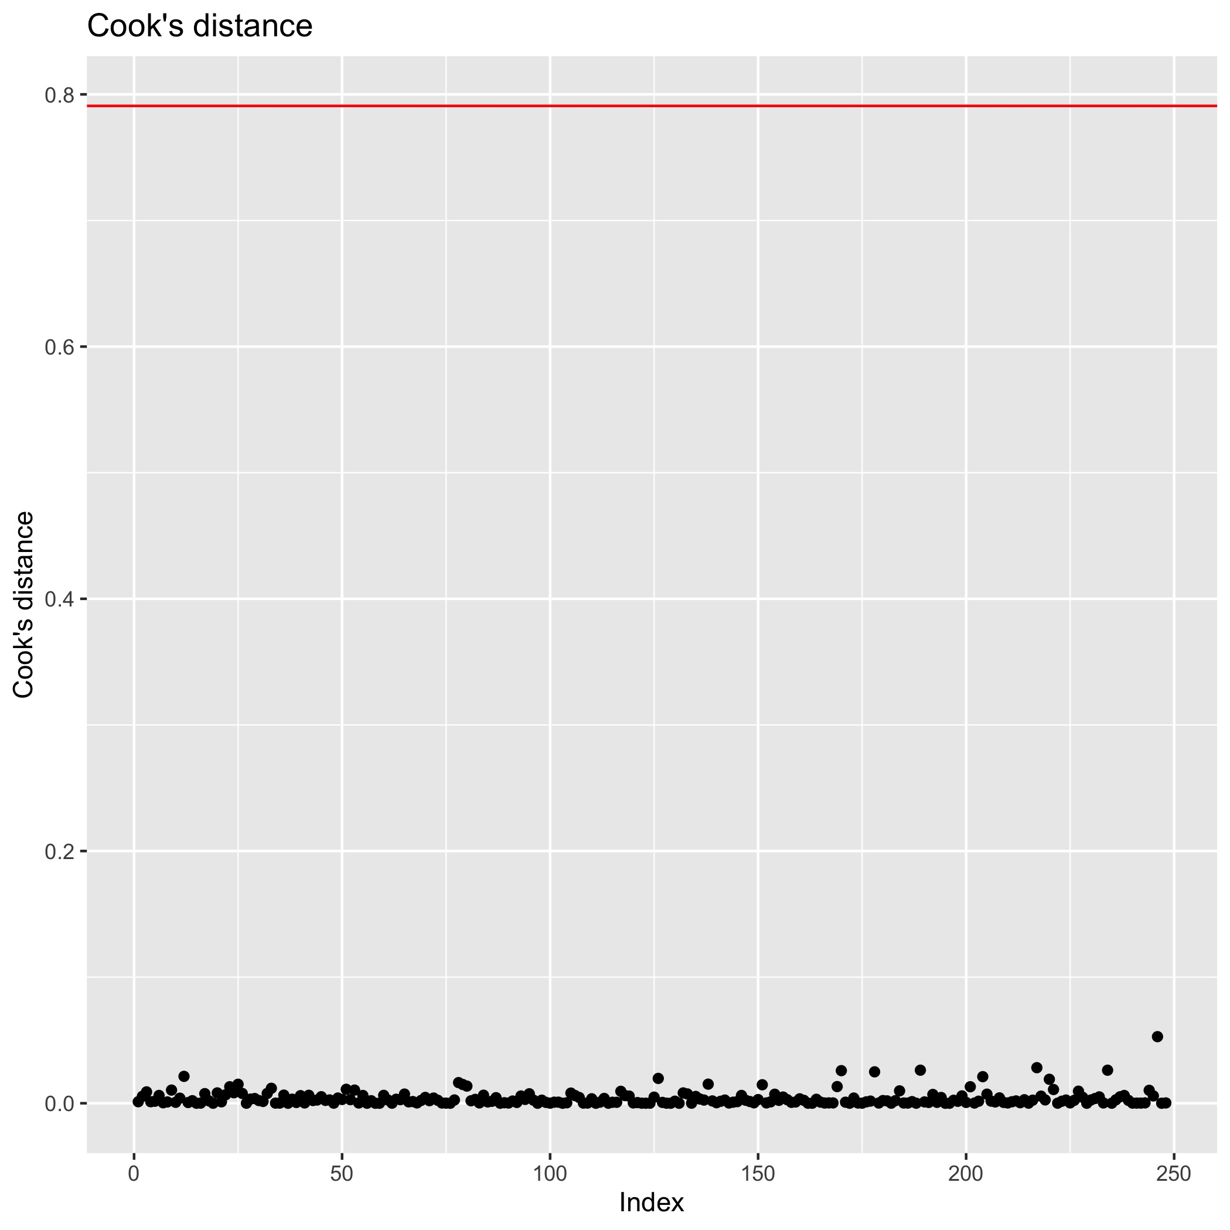
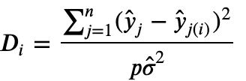

Model Diagnosis – Cook’s Distance
Cook’s distance
measure the influence of i^{th} observation on all n fitted values.
The red line is rule of influential observation.
No influential observation.

Slide 2
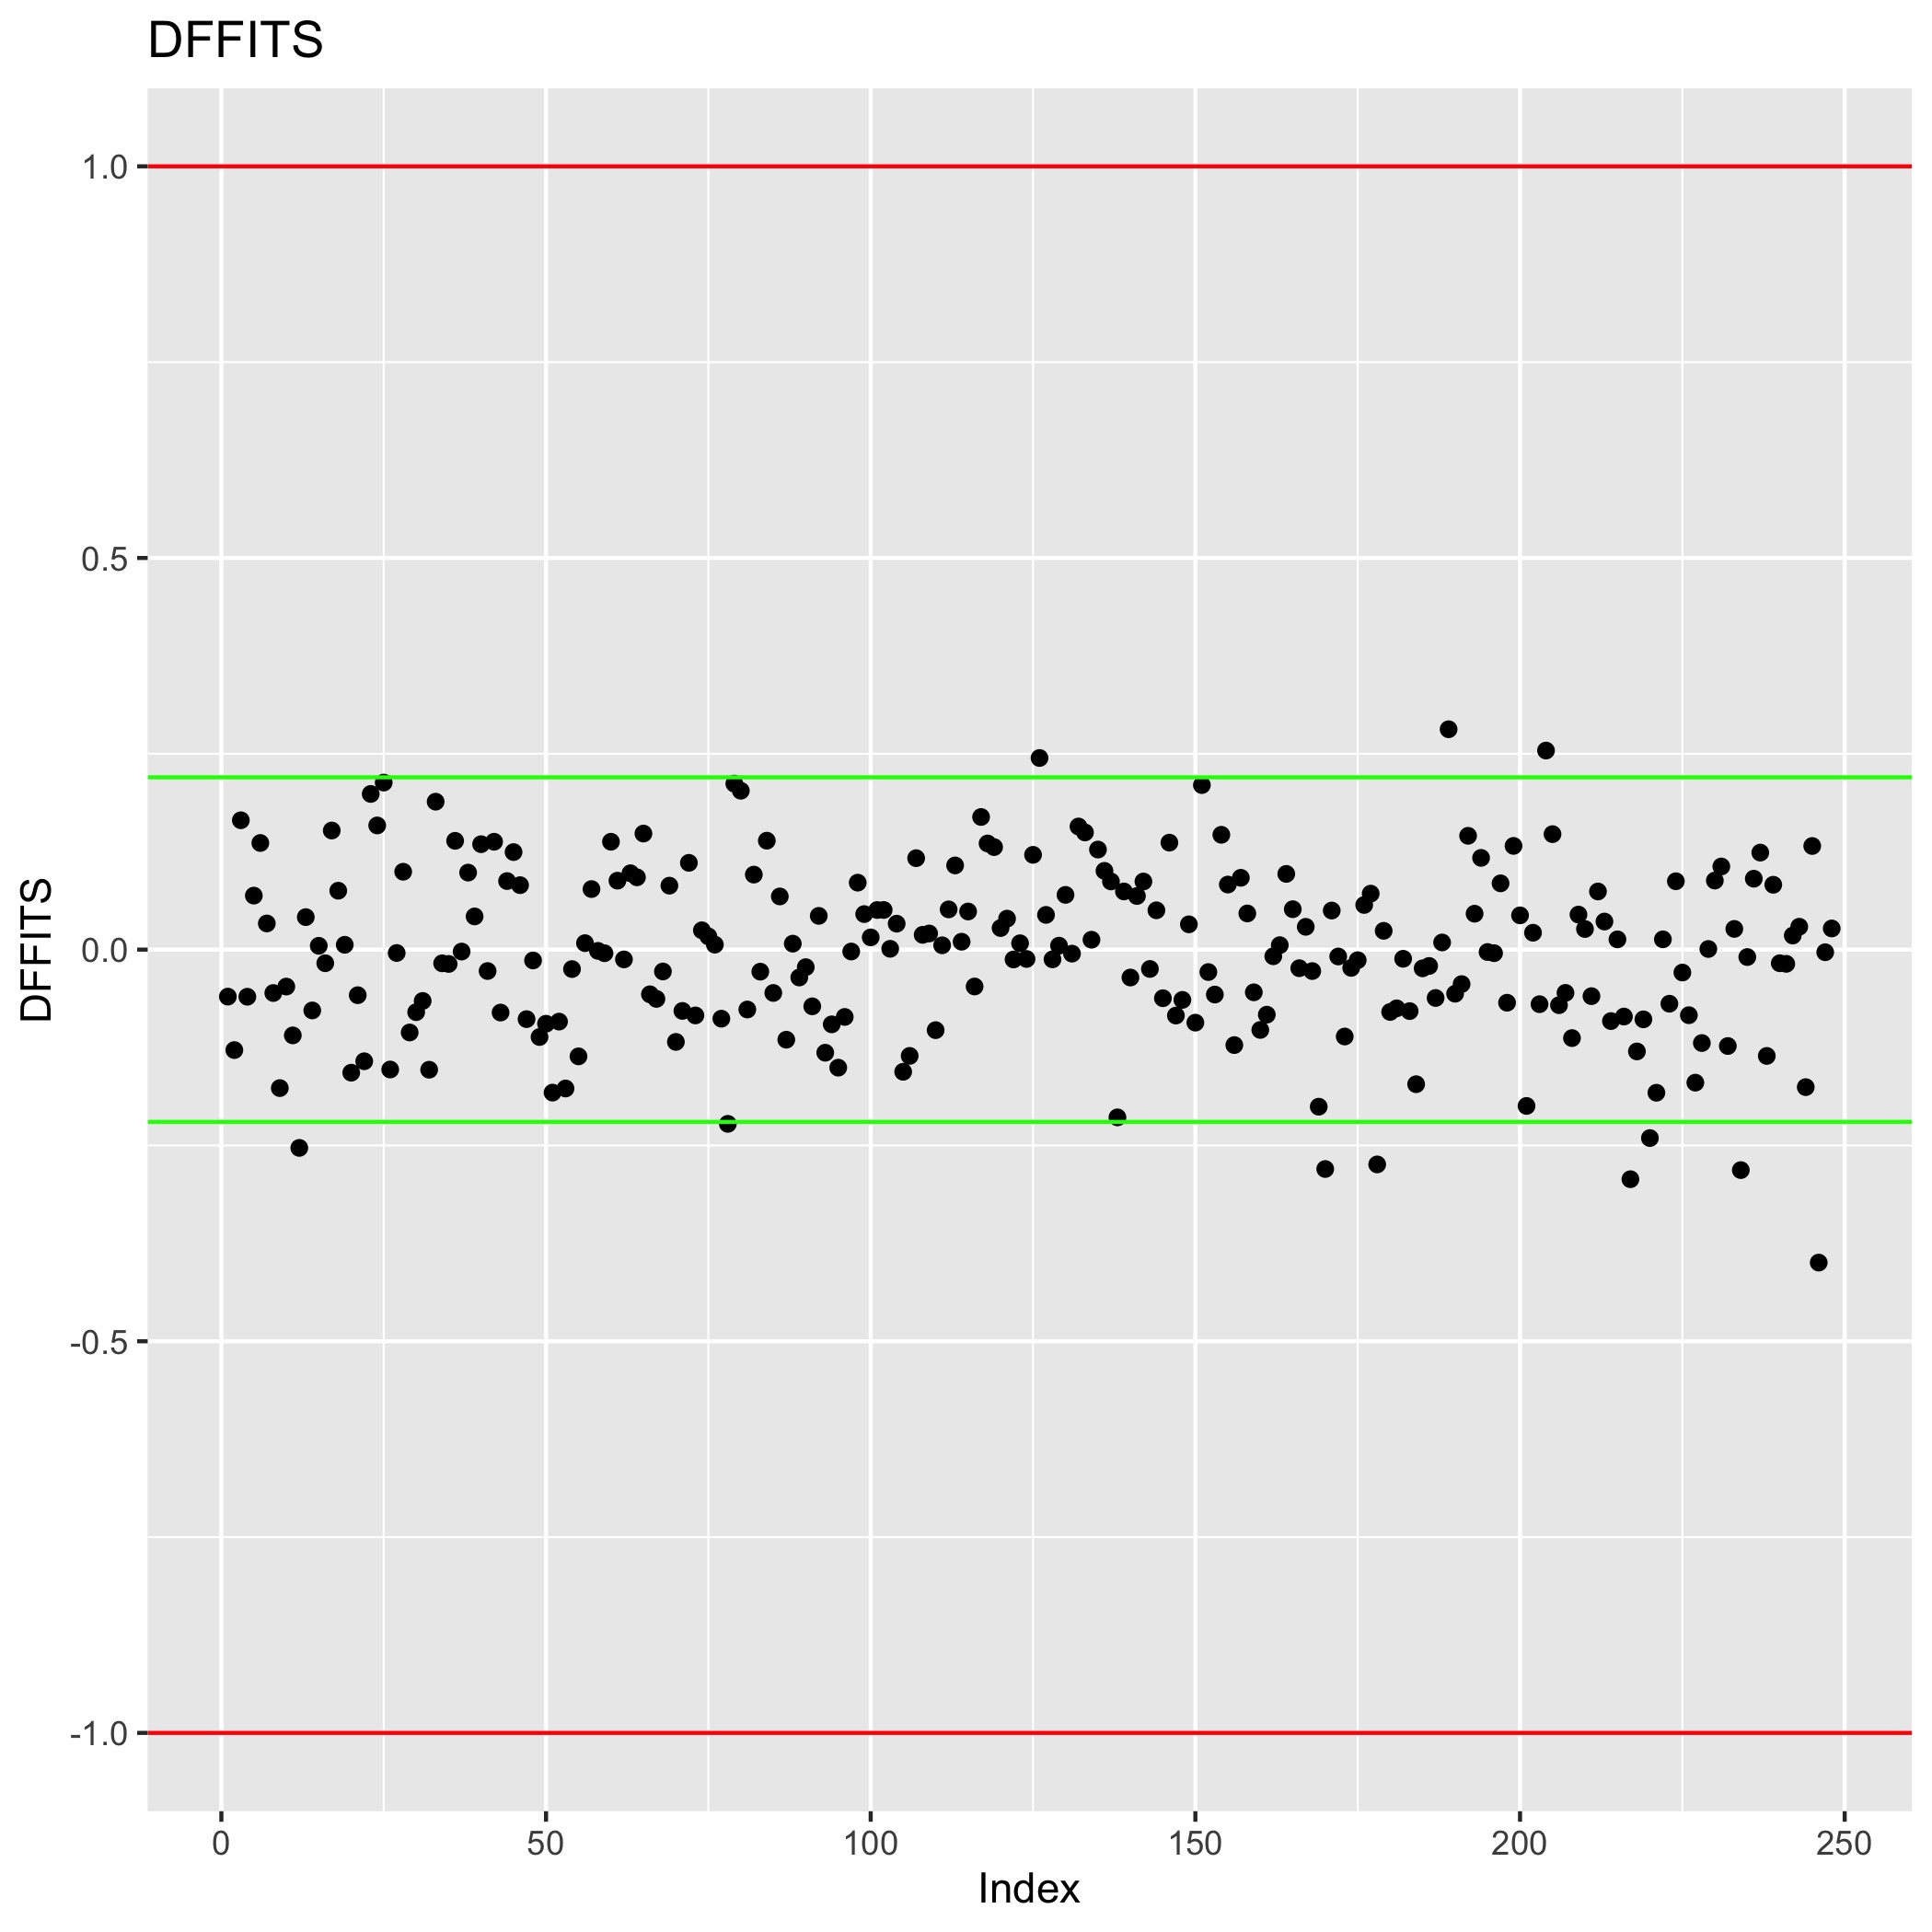
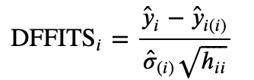
Model Diagnosis - DFFITS
DFFITS
measures the influence of the i^{th} observation on the fitted value y_{i}.
The rule of influential observation for small dataset is red lines, for large dataset is green lines.
No obvious influential observation.

Slide 3
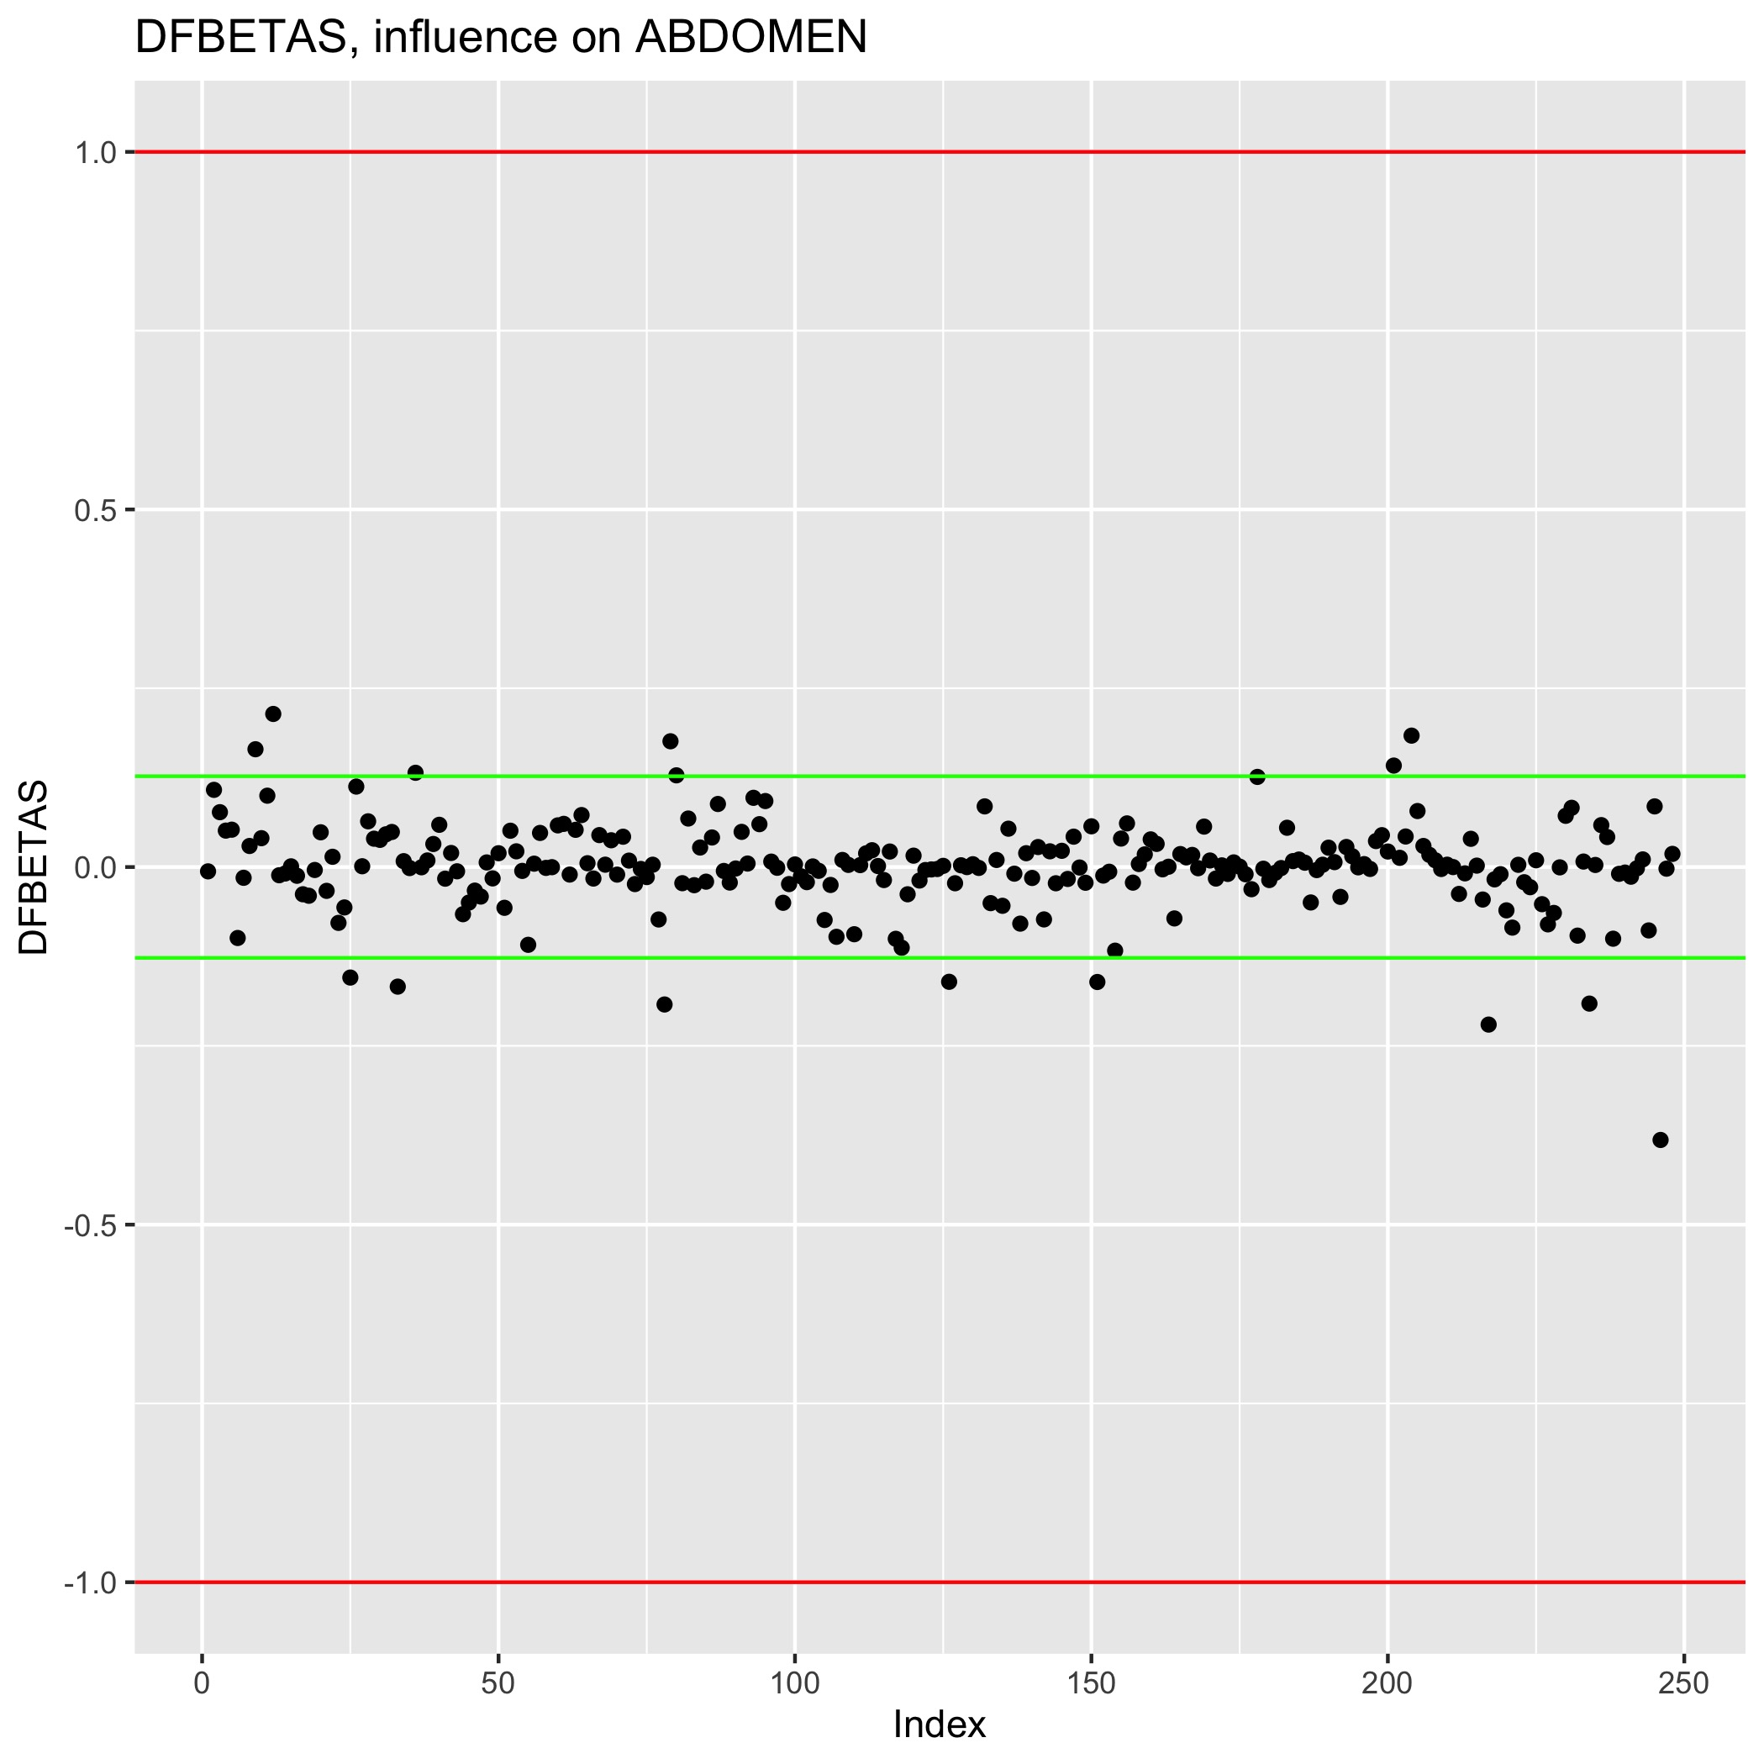
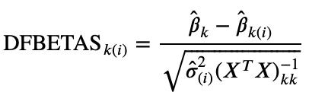
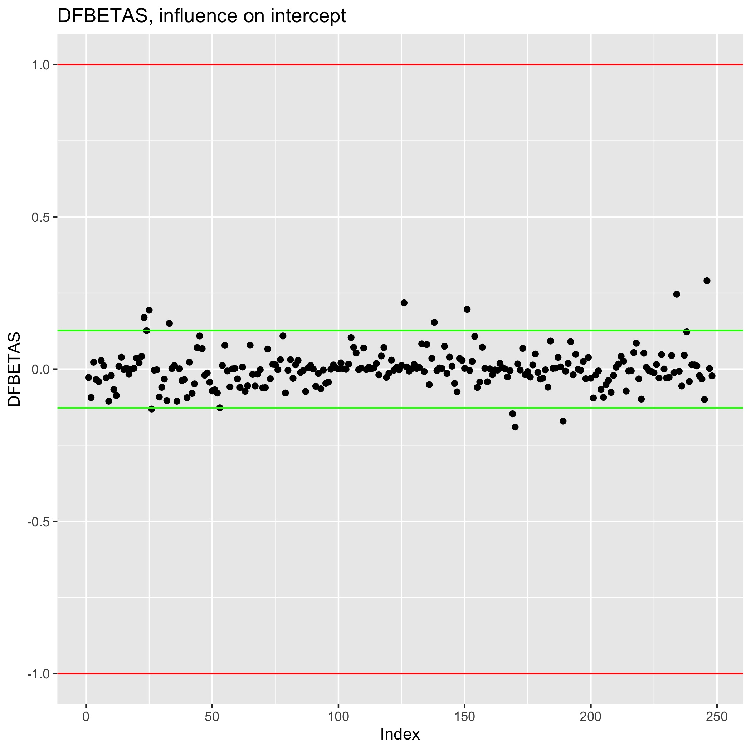
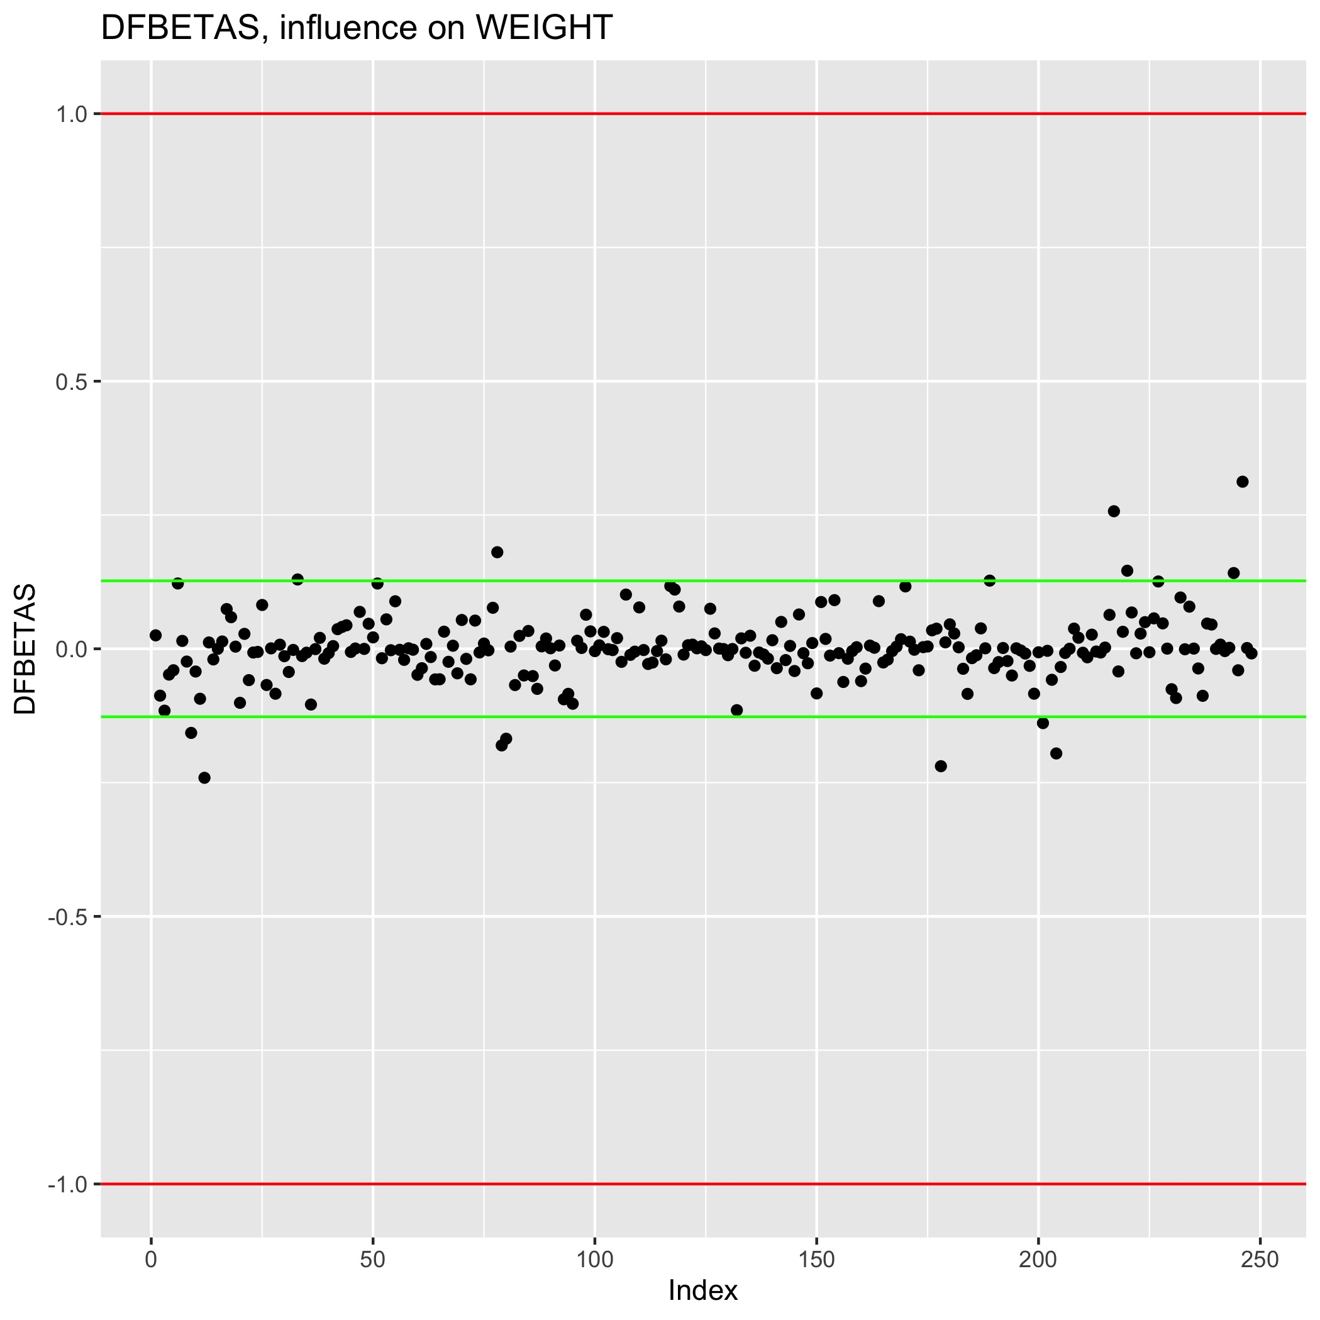
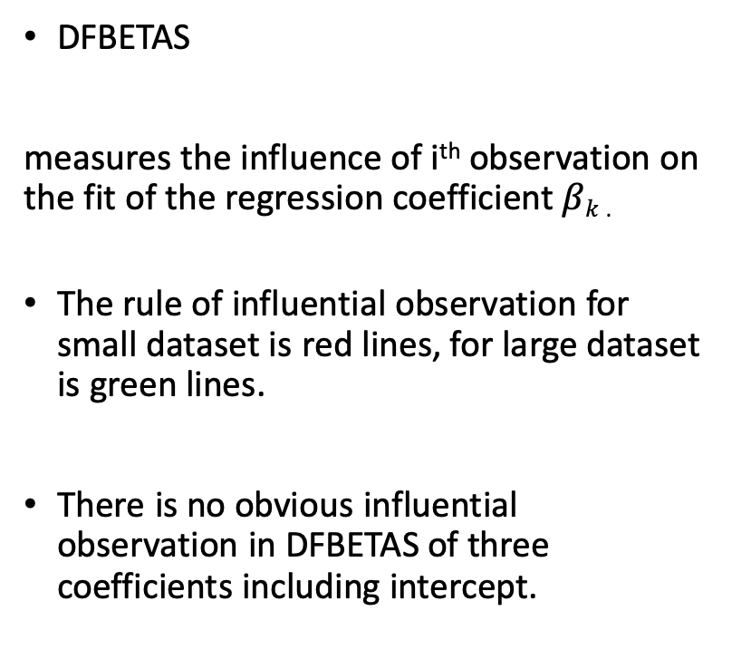
Model Diagnosis - DFBETAS
DFBETAS
measures the influence of i^{th} observation on the fit of the regression coefficient $βk$ .
The rule of influential observation for small dataset is red lines, for large dataset is green lines.
There is no obvious influential observation in DFBETAS of three coefficients including intercept.
Notes:
nhhhh

Slide 4
Model Diagnosis and Summary
Advantages:
Perform well in diagnosis.
Simple rule
No serious multicollinearity.
All linear regression assumptions hold.
Disadvantages:
The R-squared is not perfect.
Improvement:
We expect large and detailed data sets.
Is there any improvement for new variables from complex transformation and combination?

Slide 5
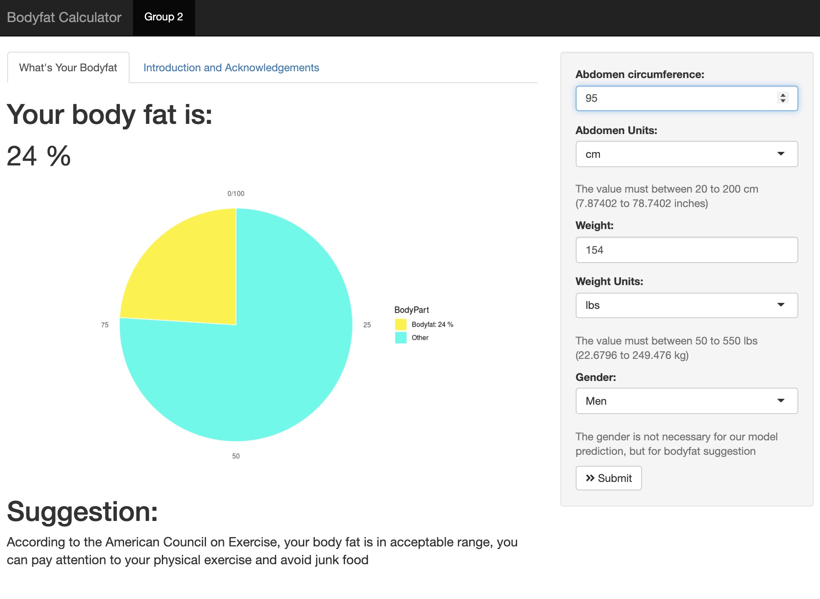
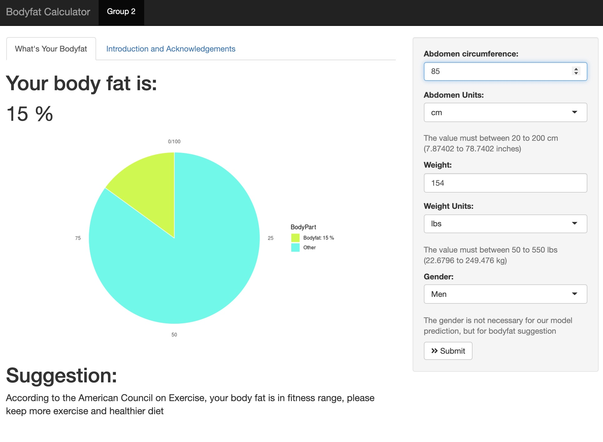
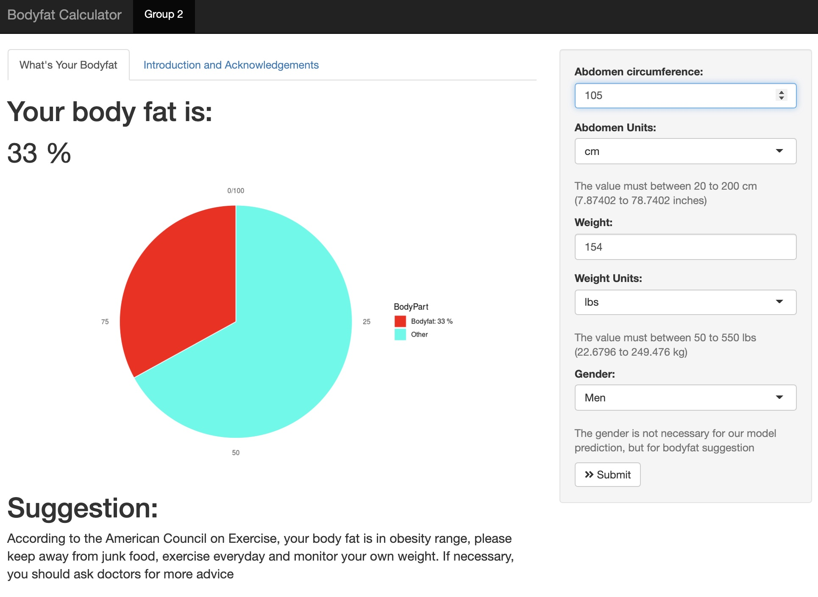
Shiny Application
Function of changing unit
Color warning when your bodyfat is high.
Body fat suggestion from American Council on Exercise

Slide 6
Acknowledge
GitHub, Main Code
Main code edited by CHENYANG JIANG and ENZE WANG
PCA edited by HanGyu KANG
Model selection fixed by RUI HUANG
GitHub maintained by ENZE WANG
Shiny App
Main edited by RUI HUANG and HanGyu KANG
The interface, ggplot and unit part are fixed, edited and maintained by ENZE WANG
Other problems are fixed by CHENYANG JIANG
Presentation
PPT edited by ENZE WANG
Video edited by HanGyu KANG
Presented with CHENYANG JIANG and RUI HUANG
PDF Summary
Main edited by ENZE WANG
Fixed by RUI HUANG, CHENYANG JIANG and HanGyu KANG

